Slide 1
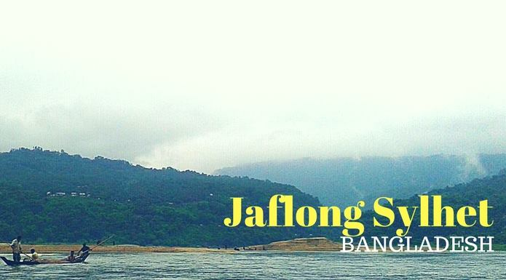
Discover the Mesmerizing Beauty of Nature

Slide 2
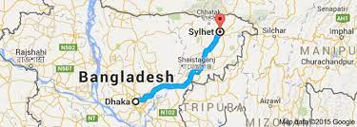
Location and Overview
Situated in Sylhet District, northeast of Bangladesh.
Located on the border between Bangladesh and India
Overview:
Known for its picturesque landscapes, serene environment, and unique stone collection culture.

Slide 3
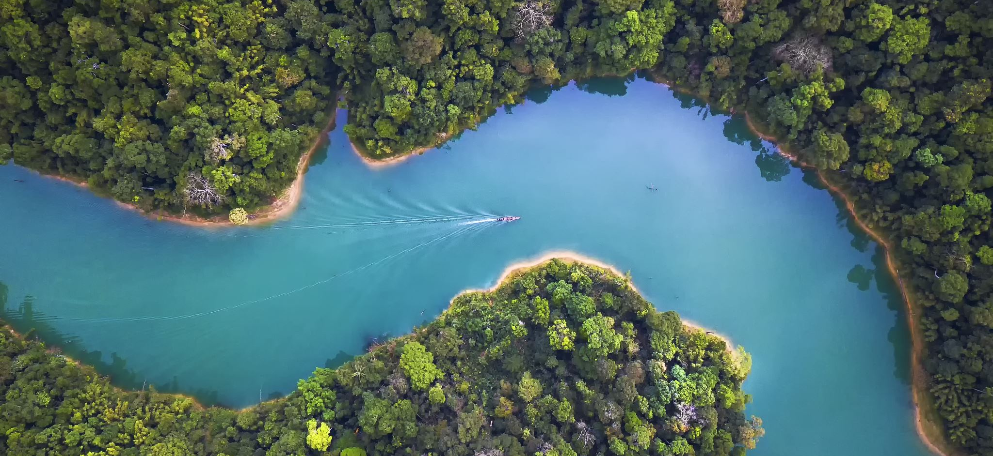
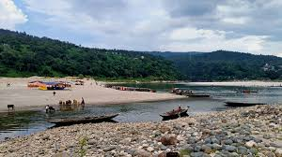
Key Attraction
Piyain River:
Crystal-clear river flowing through Jaflong.
A major attraction for boat rides and photography.
Stone Collection:
Famous for natural stone collection from the riverbed.
Locals collect colorful stones as part of their livelihood.
Tamabil Border:
Border viewpoint offering scenic vistas of Meghalaya’s rolling hills

Slide 4
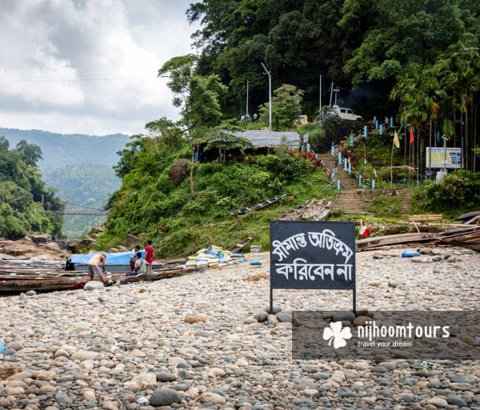
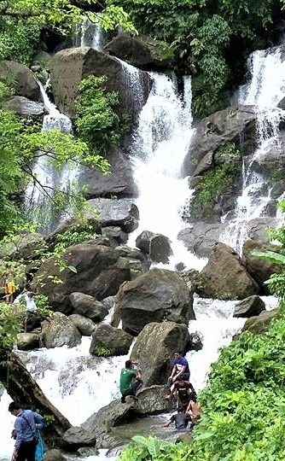
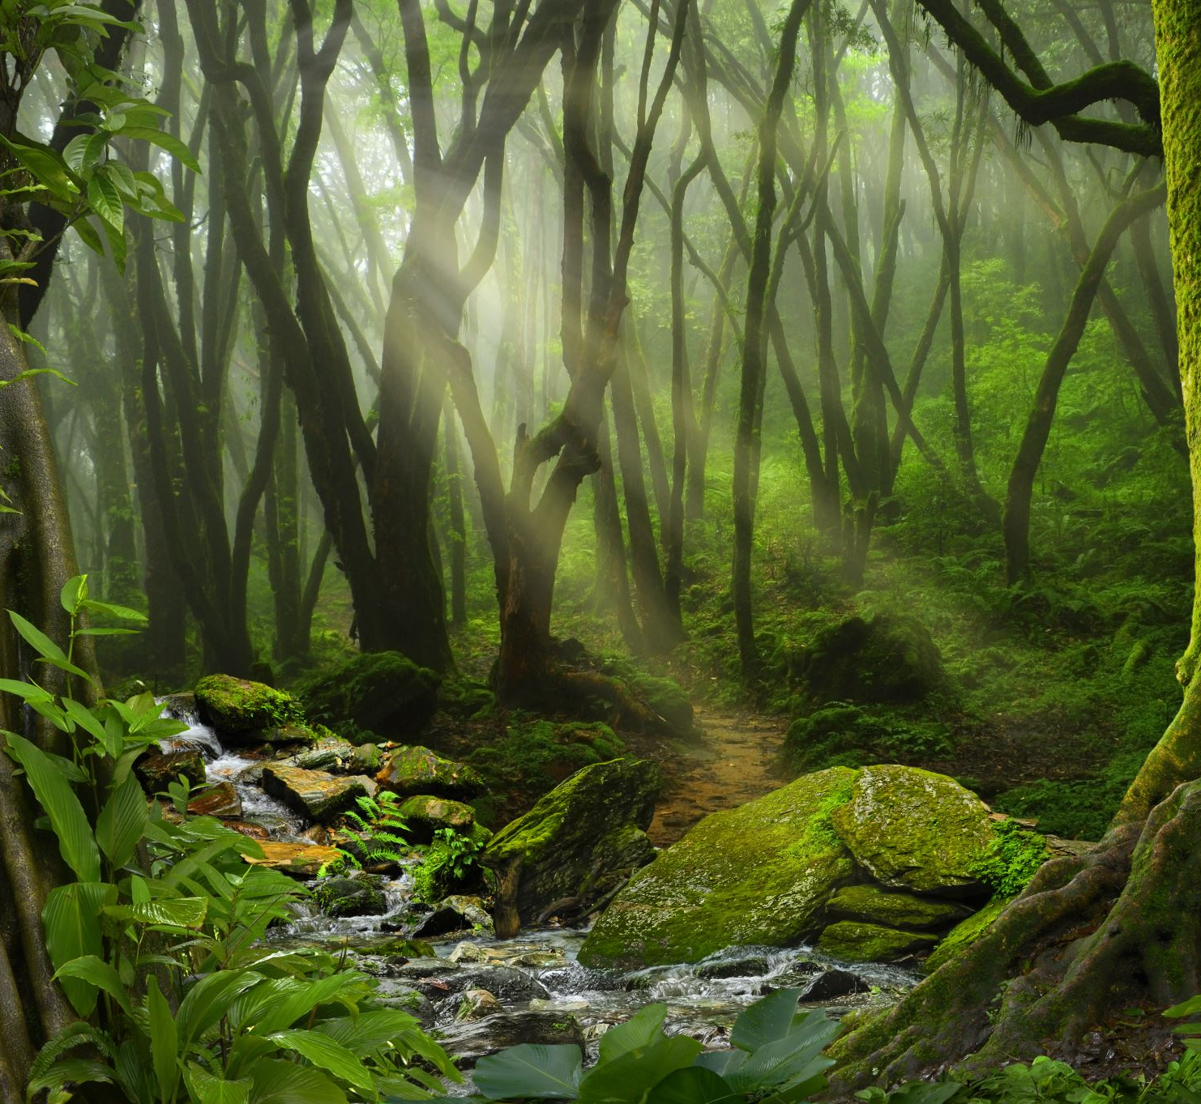
Natural Beauty
Surrounding Hills:
Covered in lush green forests.
Often shrouded in mist, especially during the rainy season.
Dawki Bridge (India):
A popular spot visible from Jaflong, adding international charm.
Flora and Fauna:
Rich biodiversity, including unique plants and birds.

Slide 5
Activities for Tourists
Boat Rides:
Enjoy peaceful boat rides on the Piyain River.
Photography:
Capture mesmerizing views of mountains, rivers, and clouds.
Picnics and Day Trips:
A popular picnic destination for families and friends.
Exploration:
Visit local villages to learn about their culture and livelihood.

Slide 6
: Cultural and Historical Significance
Cultural Heritage:
Close ties with Khasi and Jaintia tribes from Meghalaya.
Rich traditions and customs visible in the area.
Historical Importance:
Strategic location on the Bangladesh-India border.

Slide 7
Accessability
How to Reach:
From Sylhet city: About 60 kilometers by road.
Transportation: Private car, local buses, or CNG auto-rickshaws.
Best Time to Visit:
October to March for pleasant weather.
Monsoon season (June-August) for waterfalls and misty beauty.

Slide 8
Amenities
Accommodations:
Hotels and resorts available in Sylhet city.
Few local guesthouses near Jaflong.
Food:
Small eateries offering traditional Sylheti dishes and snacks.
Guides:
Local guides available for assistance and tours

Slide 9

Environmental Challenges
Pollution:
Threat from unregulated stone collection and waste disposal.
Conservation Needs:
Need for eco-tourism and sustainable practices.

Slide 10
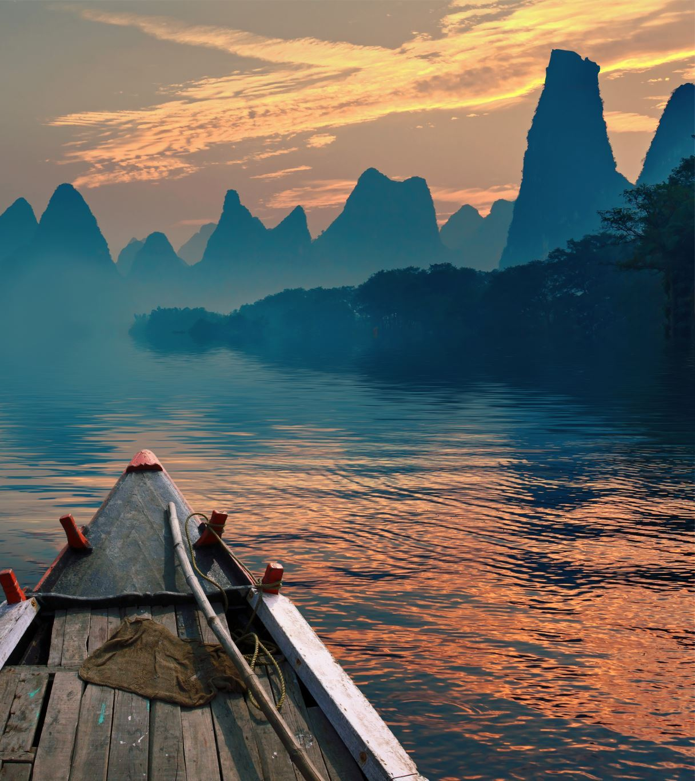
Why Visit Jaflong?
Unique Selling Points:
Unmatched natural beauty and cultural richness.
A perfect getaway for nature lovers and adventure seekers.
Memorable Experiences:
Scenic views, peaceful environment, and cultural exploration.

Slide 11
Conclusion
Summary:
Jaflong is a must-visit destination for its natural and cultural wonders.
Call to Action:
“Plan your trip to Jaflong today and experience the magic of Sylhet!”
Visuals:
A montage of photos or a map of the area.

